Slide 1
Identifying Bridges in Graphs: A Persistent Homology Approach
M. Skilleter

Slide 2

The Problem
We model a social network as a graph $X=\left(V,E,μ\right)$ with $V$ the vertex set, $E$ the edge set and $μ:V∪E→ℝ_{≥0}∪\{∞\}$ a weight function.

Slide 3

The Problem
We model a social network as a graph $X=\left(V,E,μ\right)$ with $V$ the vertex set, $E$ the edge set and $μ:V∪E→ℝ_{≥0}∪\{∞\}$ a weight function.
Communities in the network correspond to clusters in the graph.

Slide 4

The Problem
We model a social network as a graph $X=\left(V,E,μ\right)$ with $V$ the vertex set, $E$ the edge set and $μ:V∪E→ℝ_{≥0}∪\{∞\}$ a weight function.
Communities in the network correspond to clusters in the graph.
We thus want to identify vertices which don’t belong to any cluster: the bridges.

Slide 5

Early Definitions and Assumption
We may assume $X$ is connected by applying the algorithm to each path-component in parallel.

Slide 6
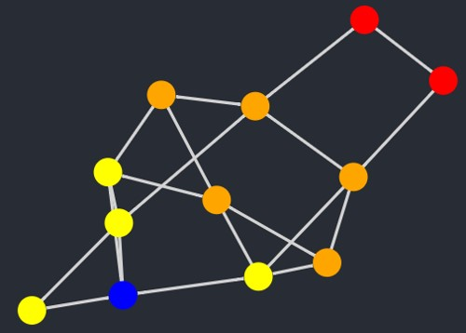

Early Definitions and Assumption
We may assume $X$ is connected by applying the algorithm to each path-component in parallel.
For every vertex $v$, we have an associated shortest path filtration of $X$. Figure 1 is an example of this filtration, with $v$ the blue vertex and the intensity increasing as we radiate out from $v$.
Figure 1: Example of shortest path filtration

Slide 7
Persistence Barcodes and the Wasserstein Distance
The shortest path filtration lets us associate a 1-dimensional persistence barcode to every vertex. The 1-dimensional persistence barcode is the only non-trivial one.

Slide 8
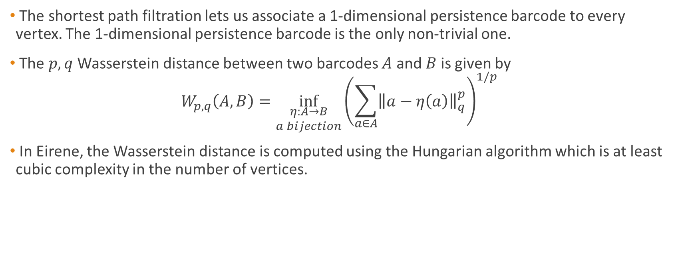
Persistence Barcodes and the Wasserstein Distance
The shortest path filtration lets us associate a 1-dimensional persistence barcode to every vertex. The 1-dimensional persistence barcode is the only non-trivial one.
The $p,q$ Wasserstein distance between two barcodes $A$ and $B$is given by
$$W_{p,q}\left(A,B\right)=\inf_{\begin{aligned}η:A→B \\ a bijection\end{aligned}}{{\left(\sum_{a∈A}{{\left\|a−η\left(a\right)\right\|}_{q}^{p}}\right)}^{1/p}}$$
In Eirene, the Wasserstein distance is computed using the Hungarian algorithm which is at least cubic complexity in the number of vertices.

Slide 9

Advantages of the Shortest Path Filtration
Because the shortest path filtration is 1-dimensional, the 1-cycle death times will all be infinite. We can model the persistence barcodes as $l×2$ matrices where $l$ is the total number of $1$-cycles in $X$.

Slide 10
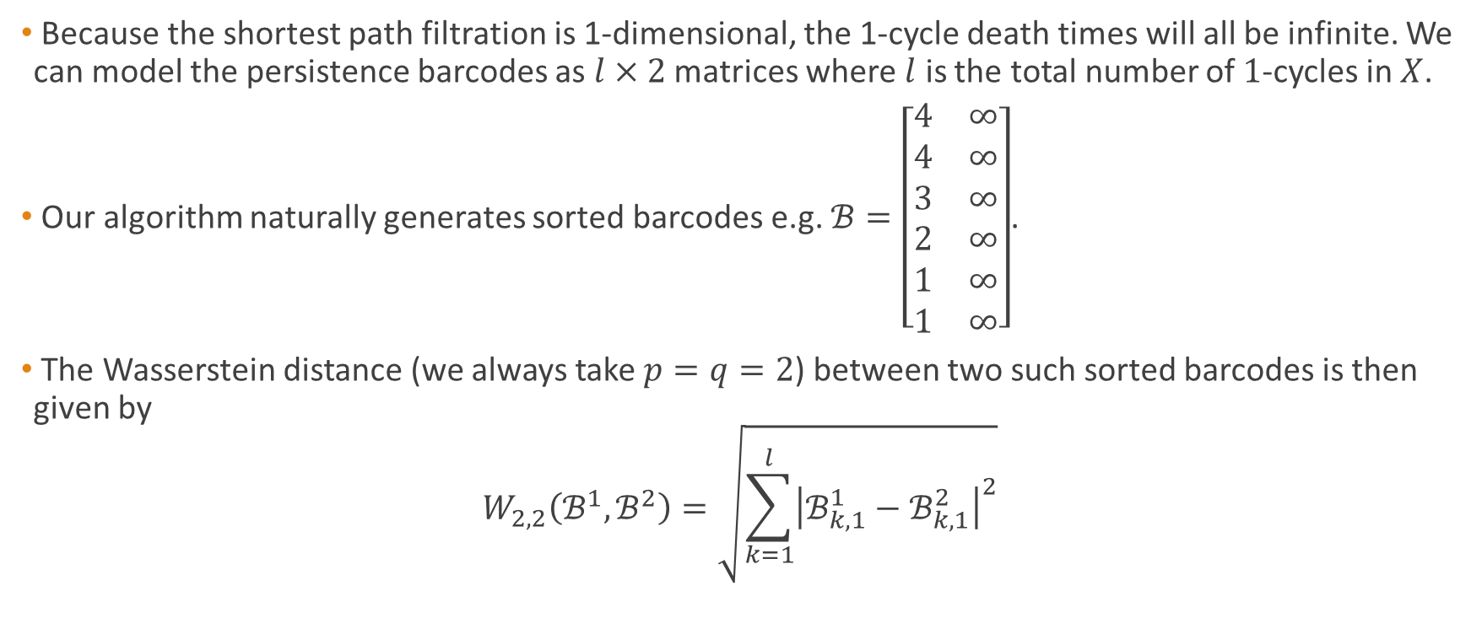
Advantages of the Shortest Path Filtration
Because the shortest path filtration is 1-dimensional, the 1-cycle death times will all be infinite. We can model the persistence barcodes as $l×2$ matrices where $l$ is the total number of $1$-cycles in $X$.
Our algorithm naturally generates sorted barcodes e.g. $ℬ=\left[\begin{matrix}4 & ∞ \\ 4 & ∞ \\ 3 & ∞ \\ 2 & ∞ \\ 1 & ∞ \\ 1 & ∞\end{matrix}\right]$.
The Wasserstein distance (we always take $p=q=2$) between two such sorted barcodes is then given by
$$W_{2,2}\left(ℬ^{1},ℬ^{2}\right)=\sqrt{\sum_{k=1}^{l}{{\left|ℬ_{k,1}^{1}−ℬ_{k,1}^{2}\right|}^{2}}}$$

Slide 11
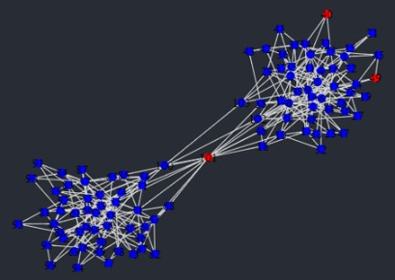
Refining the Search
Figure 2 is an example graph generated using more classical clustering methods.
Figure 2: Example graph clustered using the annulus test.

Slide 12
Refining the Search
Figure 2 is an example graph generated using more classical clustering methods.
Using the Wasserstein distance, the vertices in the upper right-hand corner can be said to be “close enough” to neighbouring cluster points to also be part of the cluster.
Figure 2: Example graph clustered using the annulus test.

Slide 13
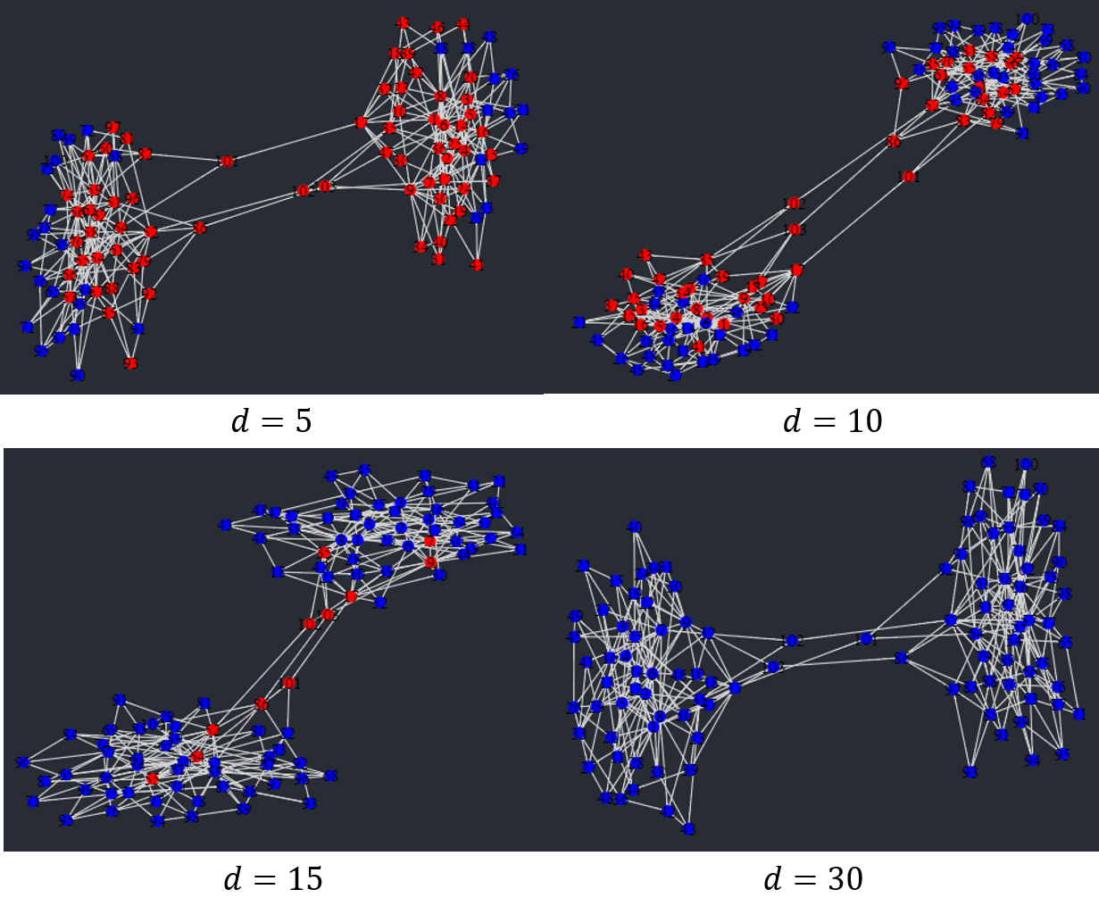

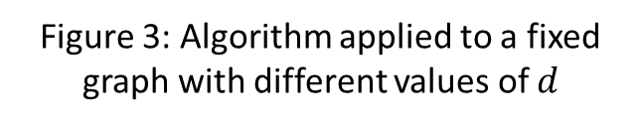
An Upper Bound of Wasserstein Distance
The value of $d$, the upper bound on the Wasserstein distance between two cluster points, greatly affects the accuracy of the algorithm. Figure 3 is an example of this.
Choosing the value of $d$ is a problem that we are still investigating.
Figure 3: Algorithm applied to a fixed graph with different values of $d$

Slide 14
Solving an Extremal Problem
We count the number of 1-cycles born at each stage of the filtration. Intuitively, a cluster point should have a large portion of 1-cycles born early in the filtration while there should be an initial delay for a bridge.

Slide 15
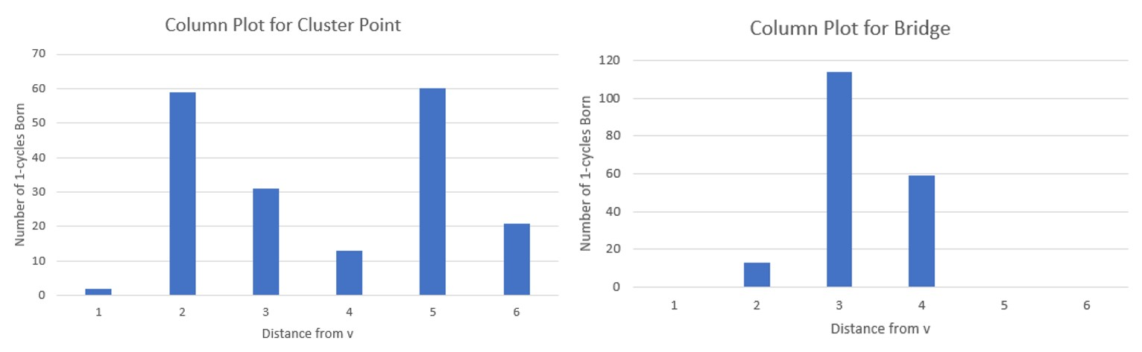
Solving an Extremal Problem
We count the number of 1-cycles born at each stage of the filtration. Intuitively, a cluster point should have a large portion of 1-cycles born early in the filtration while there should be an initial delay for a bridge.
Figure 4: Column plots showing number of 1-cycles born at each stage of the shortest path filtration

Slide 16
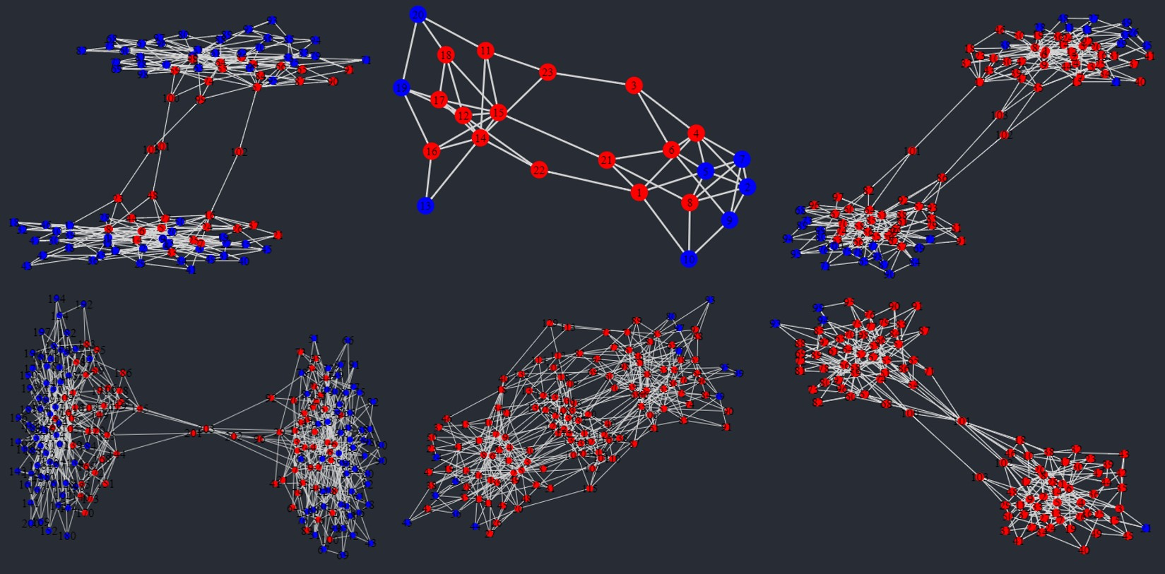
Solving an Extremal Problem
Figure 5: Initial cluster points using the 1-cycle birth times test

Slide 17
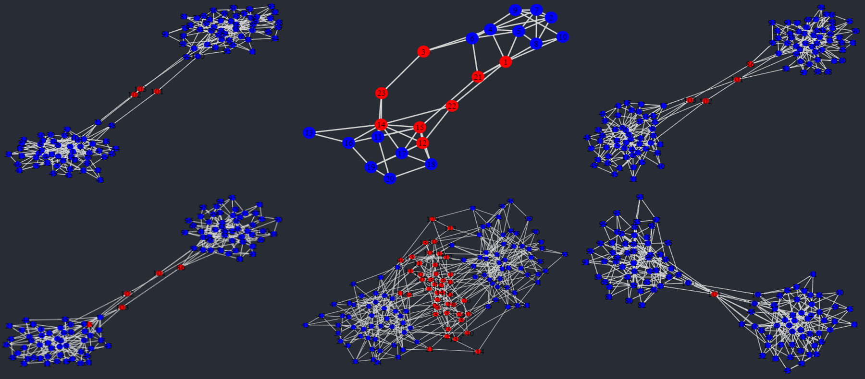
The Algorithm Applied

Slide 18
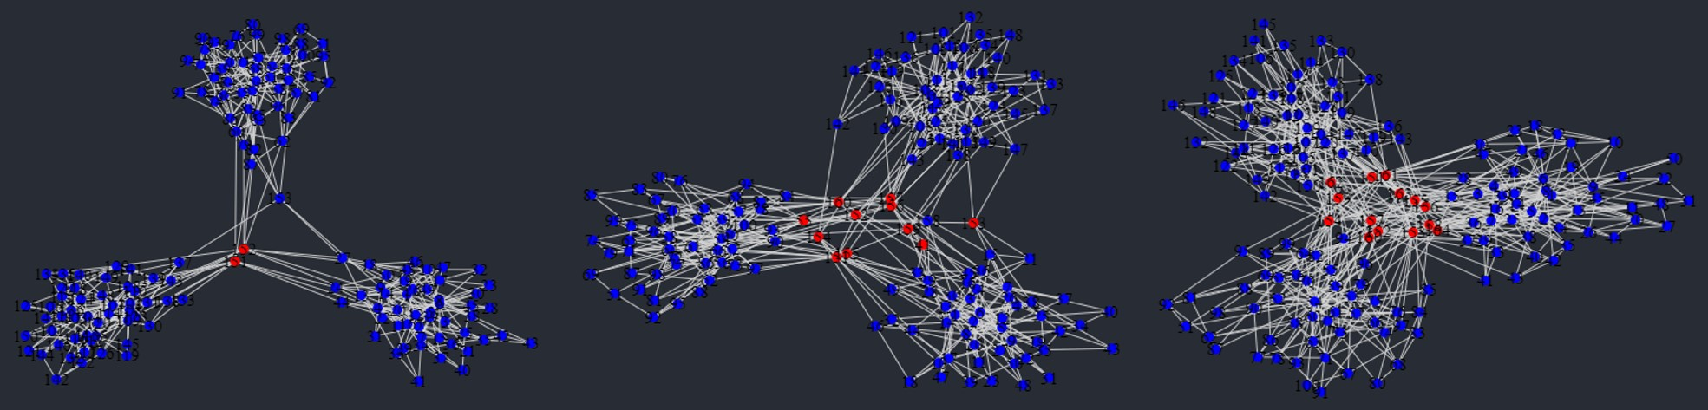
The Algorithm Applied

Slide 19
References
A. Hatcher (2002). Algebraic Topology. Cambridge University Press. Available at https://pi.math.cornell.edu/~hatcher/AT/AT.pdf
M. Kerber, D. Morozov, A. Nigmetov (2016). Geometry Helps to Compare Persistence Diagrams. Available at https://arxiv.org/abs/1606.03357
B. Slininger. Fiedler's Theory of Spectral Graph Partitioning. Available at http://citeseerx.ist.psu.edu/viewdoc/download?doi=10.1.1.592.1730\&rep=rep1\&type=pdf
D. Spivak (2009). Higher-dimensional models of networks. Available at https://arxiv.org/abs/0909.4314
S. Bhatia, B. Chatterjee, D. Nathani, M. Kaul (2018). Understanding and Predicting Links in Graphs: A Persistent Homology Perspective. Available at https://arxiv.org/abs/1811.04049
D. Yan, L. Huang, M. Jordan. Fast Approximate Spectral Clustering. Available at https://people.eecs.berkeley.edu/~jordan/papers/yan-etal-long.pdf
D. Centola, M. Macy. Complex contagions and the weakness of long ties. In: American Journal of Sociology 113.3 (2007), pp. 702-734.
R. Ram, M. Rizoiu (2019). A social science-grounded approach for quantifying online social influence. In: Australian Social Network Analysis Conference (ASNAC'19) (p. 2). Adelaide, Australia.

